Slide 1

Single Cell RNAseq Analysis in R with Seurat
July 2025

Slide 2









I would like to acknowledge the Traditional Owners of the lands on which I am speaking to you today, the Turrbal and Jagera people.​
​
I also acknowledge the Traditional Owners of the lands on which each of you are working from. ​
​
I acknowledge their continuing connection to their culture and pay my respects to their Elders past and present
Members & Partners
‹#›

Slide 3
Single cell RNAseq Analysis

Slide 4
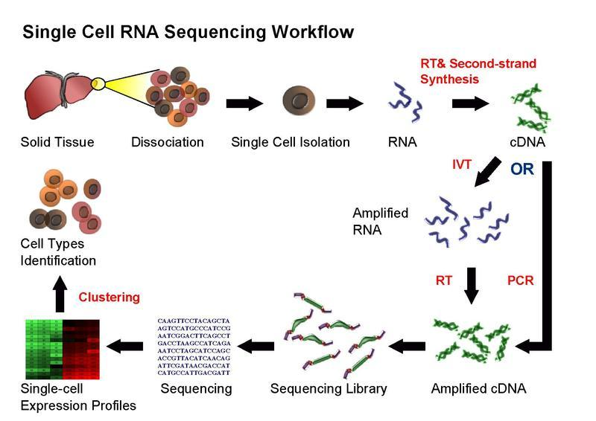
Single Cell RNAseq

Slide 5
Single Cell RNAseq Analysis Workflow
Sequence QC
Align
Raw data to Counts Matrix
Count
Cell QC + Filter
Counts matrix scRNAseq analysis
Normalisation
Reduce dimensions
Today’s workshop
Cluster
Differential expression Trajectories
Multiomics
Integration
Ligand-receptor interactions
velocity
…
Marker Finding
Cell Types
+ More!

Slide 6
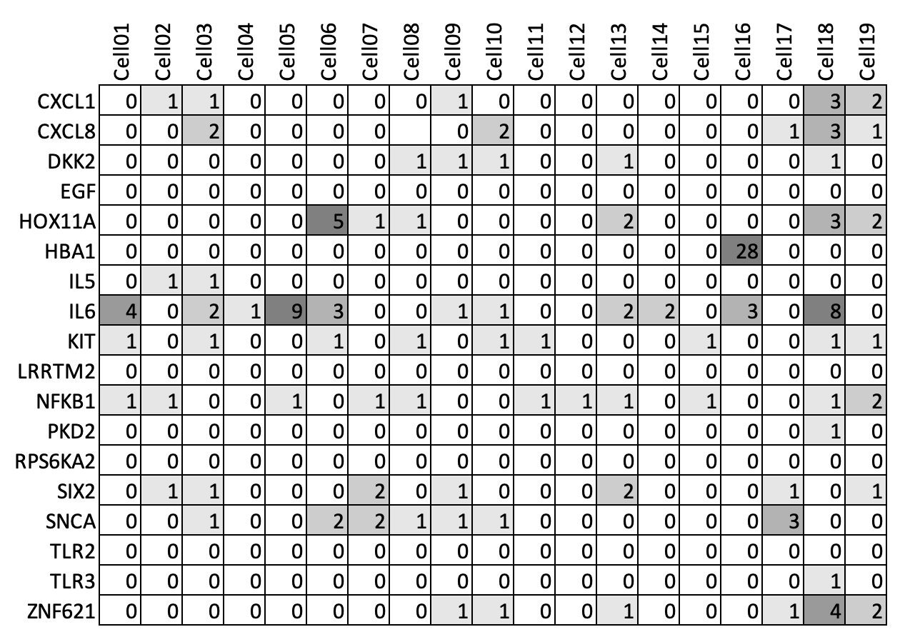
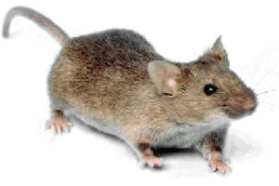
Raw data to Counts Matrix
Raw reads
(fastq files)
> read1
CAGCGATTACAC
> read2
CACACCGGCAG
...
CTTTA
CACACCGGCAG
CTCACAGGACA
GTTACATCATGG
(aligned to genome)
Tools:
starSOLO
10X CellRanger
Alevin
Notes:
Relative routine.
Dependant on the technology
Counts matricies often available on GEO…. let someone else do the work!
Not going into any more detail than this - its own process

Slide 7
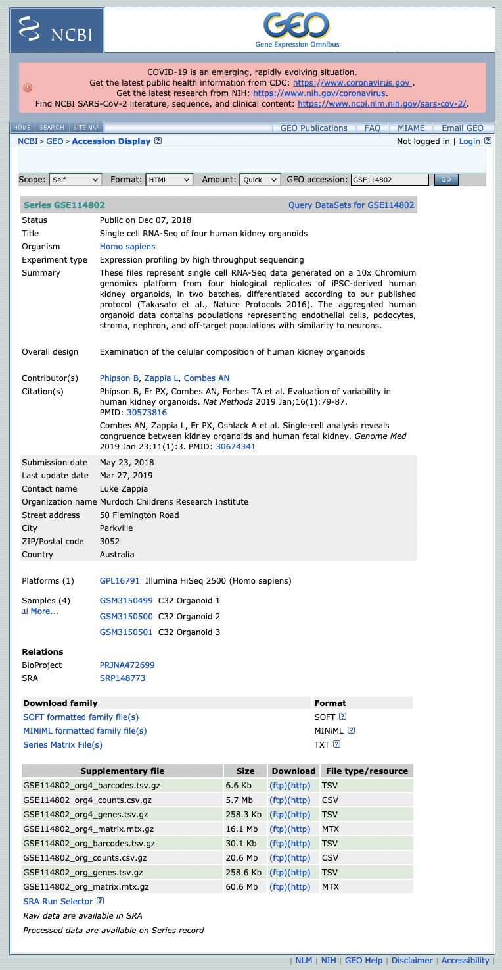
Why start with counts matrix?
https://www.ncbi.nlm.nih.gov/geo/query/acc.cgi?acc=GSE114802
A standard output of cellRanger (10X pipeline)
Often available for Public data!

Slide 8
What we will cover

Slide 9
Counts Matrix

Slide 10
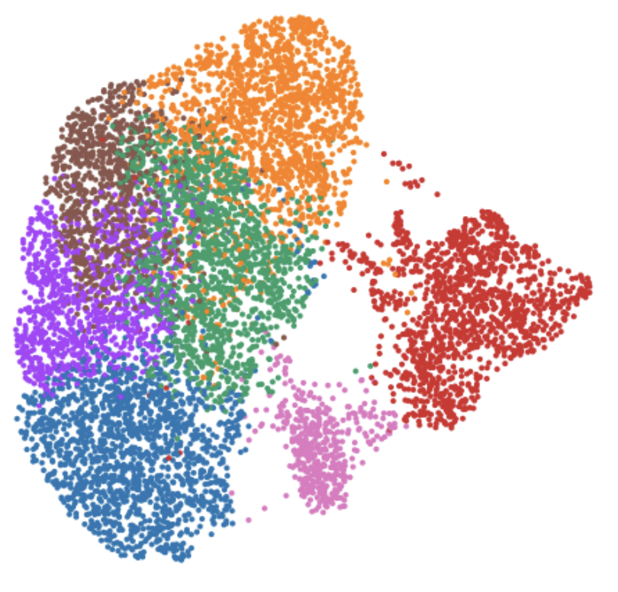
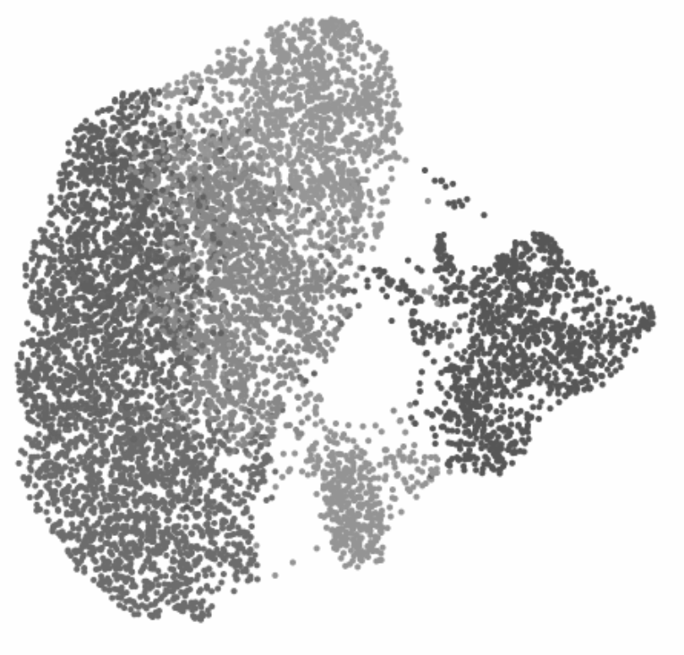
Counts matrix to single-cell analysis
Cenpf
Mki67
Top2a
Cell QC + Filter
Normalisation
Reduce dimensions
Cluster
Marker Finding
Cell Types

Slide 11
What we won’t cover

Slide 12
Technology landscape
Much more than just ‘scRNAseq’
CITE-seq – protein assays
VDJ – Immune profiling
Spatial – CosMX, xenium, merfish, visium e.t.c
ATAC – chromatin accessibility
Variant analyses
Differences between different technologies
10X vs BD rhapsody vs ….
Notes:
There’s too much!

Slide 13
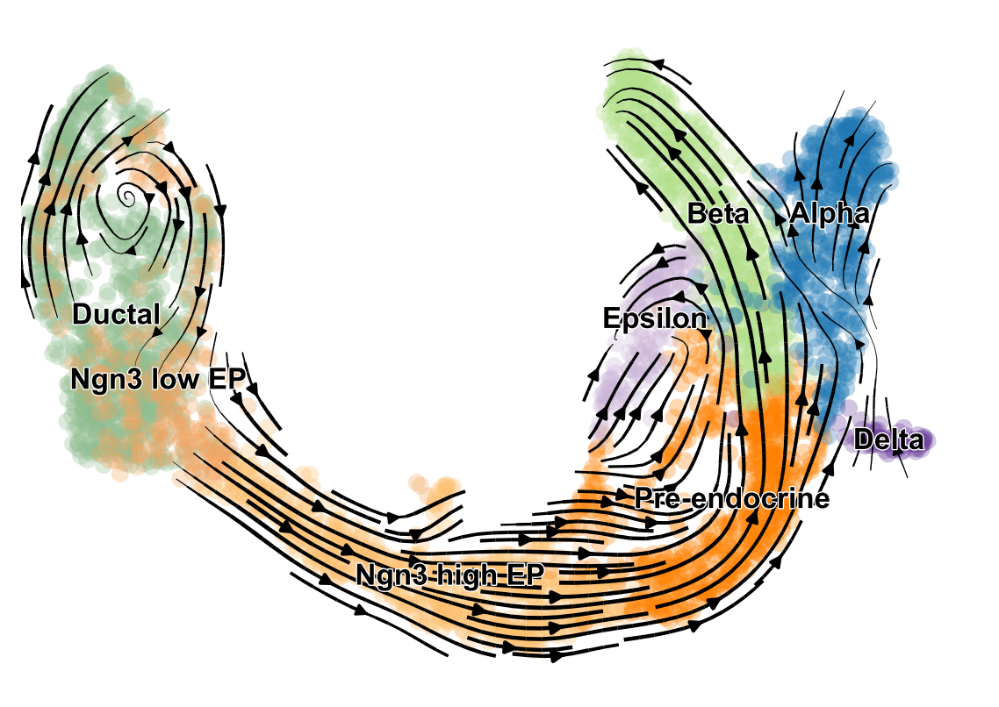
Downstream analyses
Beyond the basics:
Developmental trajectories and RNA velocity
Batch correction
Interactive visualisation tools
Multimodal analyses
Multiple dataset integration
...
We are happy to chat about these at the end though ☺
scVelo
+ More!
Notes:
But we’ll cover the steps that will prepare your data for these methods!

Slide 14
Single cell Analysis Ecosystems

Slide 15



Single cell RNAseq Analysis Ecosystems
Bioconductor: R repository of many bioinformatics analysis packages. Single cell packages in Bioconductor make use of the singleCellExperiment class
Seurat: R packages that has decided to make themselves a one-stop shop for most common single cell analysis tasks, uses the Seurat class
Scanpy: Python toolkit for single cell analysis. Uses the anndata class. Large ecosystem of tools that integrate with scanpy
SingleCellExperiment
Seurat
AnnData
Scran
batchelor
MAST
Slingshot
Seurat/Signac
Scanpy
CellRank
scVelo
Scater
SingleR
Cicero
Cyclone
CellOracle
scrublet
iSEE
chromVar
Monocle
Monocle
Harmony
Cicero
MAGIC
SPRING
PHATE
SCATE
BASiCS
schex
chromVar
batchelor
Palantir
Harmony
bbknn
DropletUtils
zellkonverter
Episcanpy
schex
And < 20 others…
And many others…
And 100s more…
All are good options and well supported!

Slide 16
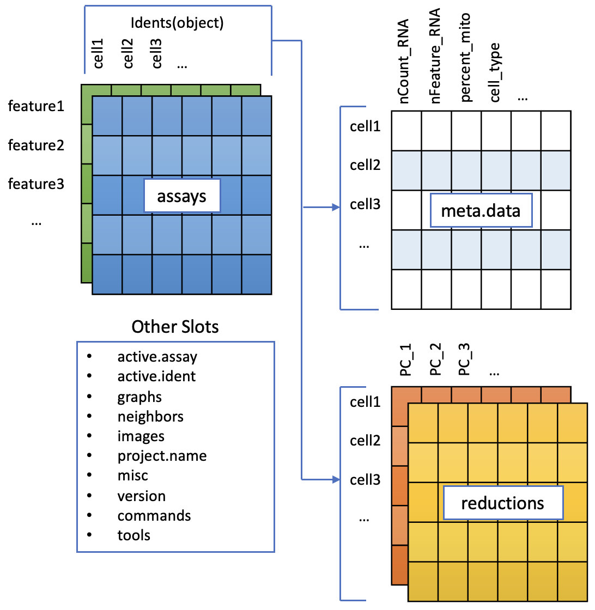
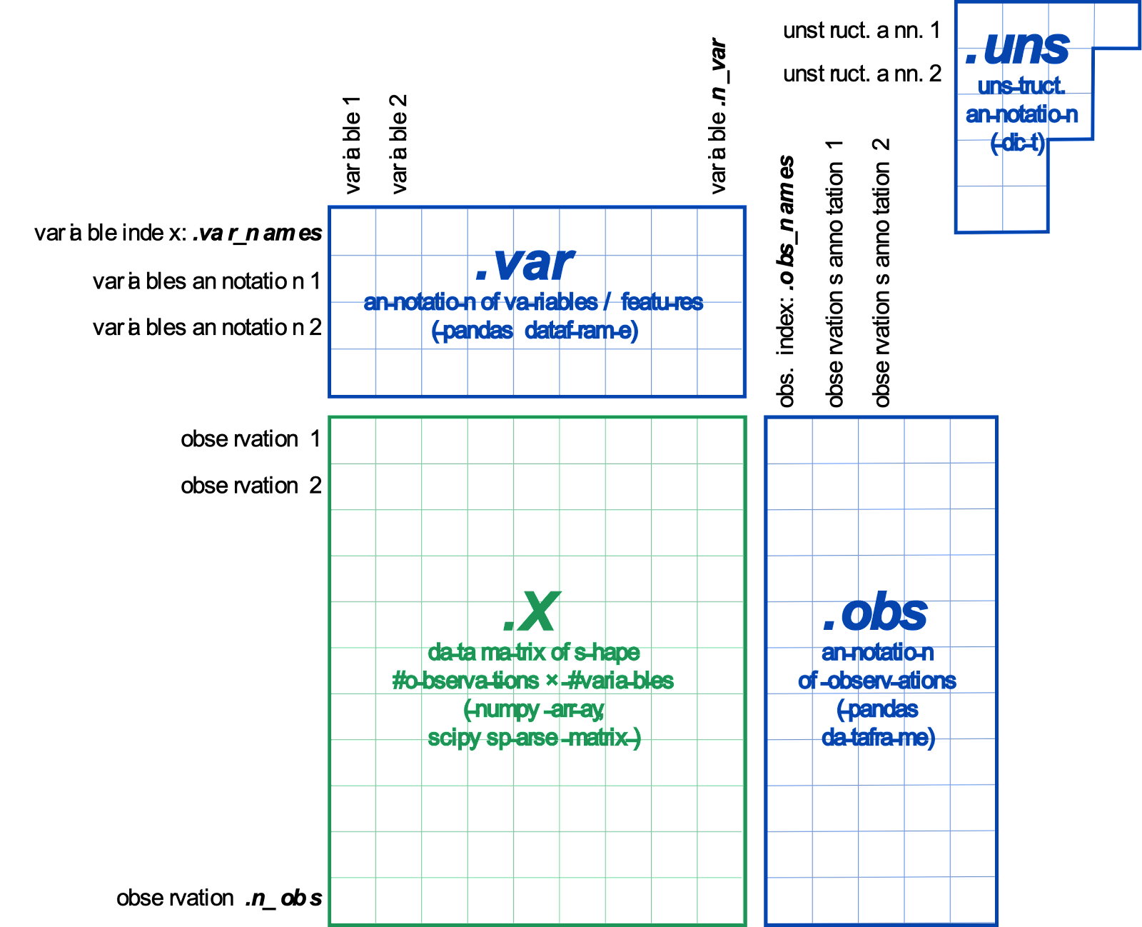
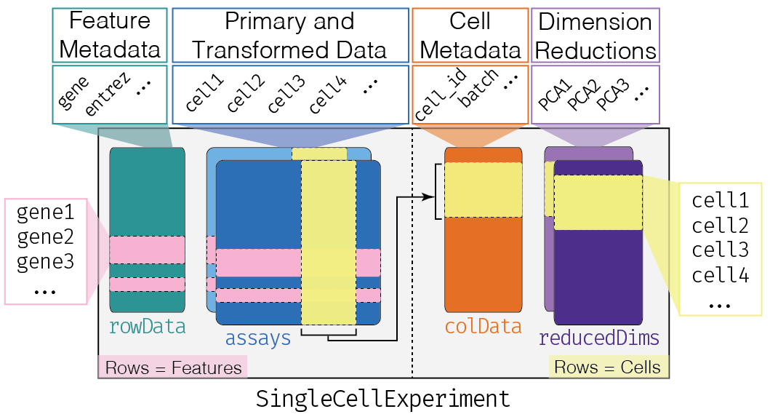
Single cell RNAseq Analysis Ecosystems
Each system has its own central data structure - Conversion is difficult, but not impossible!
SCE object saved in MyData/
Seurat object: MyData.rds
Anndata object: MyData.hdf5

Slide 17
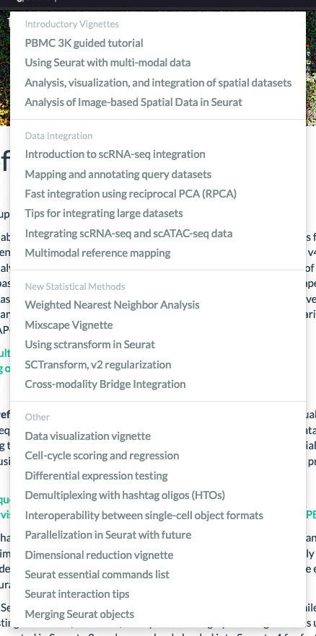
Why Seurat?
R package
Widely used
Fantastic tutorials - We’re following one today!
Excellent workflows for the routine tasks
https://satijalab.org/seurat/
Notes:
Go to Seurat websitehttps://satijalab.org/seurat/

Slide 18
Compute requirements
For today’s workshop
Your laptop with R and Rstudio, with packages installed
For a real analysis
Some steps (e.g. integration) are RAM heavy and scales with size e.g. 64Gb +. Most steps can be run with 16G.
Modern datasets are much bigger than todays’ demo data (which could run on a laptop!)
Interactivity with your data is important, but sometimes you’ll have to move it to a different server to run something overnight.
If you’re making your own counts matrix from raw data (fastqs) it’s a different task.
Suited to local HPC clusters
More data on disk, less ram needs.
Where to get compute? See what what are your colleagues using? Contact your eResearch group, Or talk to us at QCIF :) (google QCIF members advice)

Slide 19
Download Data
Data links are in google doc
Data for workshop download – 525Mb
data_full.zip : Everything
Partial Downloads – if your internet can’t handle the full download in time.
Bare essentials if you can’t download full data. Missing some preprocessed examples.
pbmc_only_data.zip (8mb): For main workshop
Kang2018.rds (24Mb): For differential expression part
Unzip .zip files in your working directory.

Slide 20
Workshop

Slide 21





Single cell RNAseq analysis in R:
Normalization and Scale
26 and 27 September 2023
biocommons.org.au
Follow us on:
Notes:
Welcome to this workshop on Single cell RNAseq analysis in R. My name is Melissa Burke and I’m the Australian BioCommons Training and Communications Officer. I am your host for this workshop.
This workshop is part of a program of events offered by the BioCommons. Our events uplift life science research by creating opportunities to develop transferable skills in bioinformatics and to learn how to use new platforms, tools, services and techniques.
You can find out more about how we’re supporting life science research on our website or by following us on social media.

Slide 22
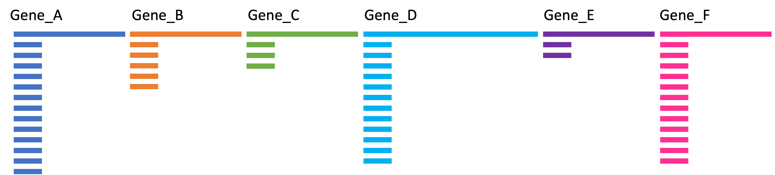
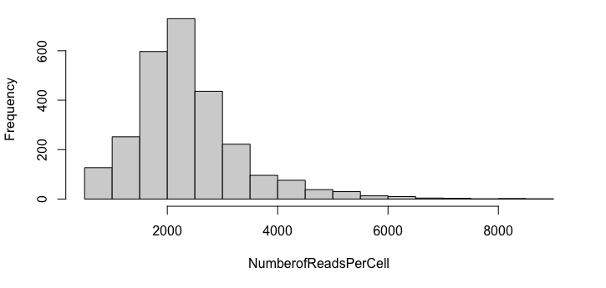
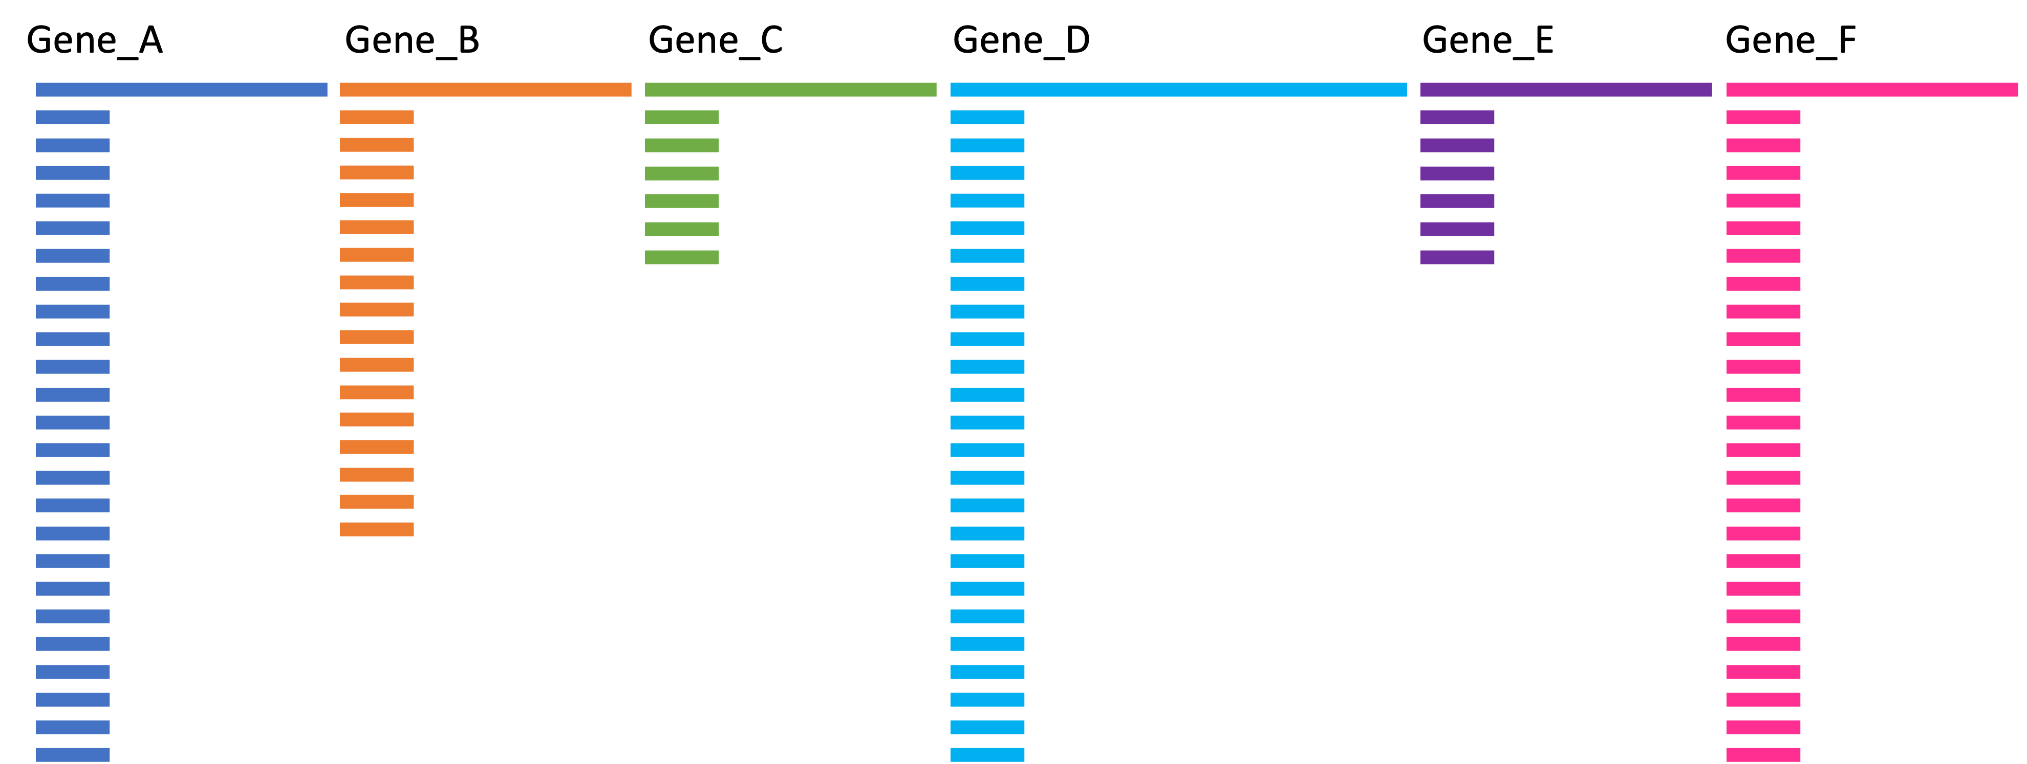
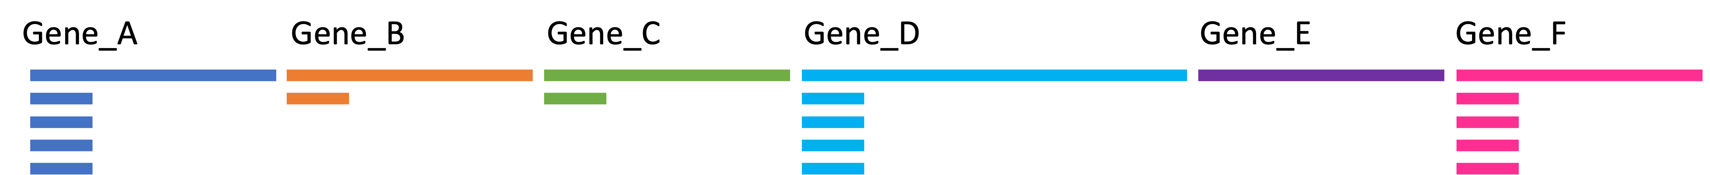
Cells can have different sequencing depth
Number of Cell
Number of Reads per Cell/ Library size/ Sequencing Depth

Slide 23
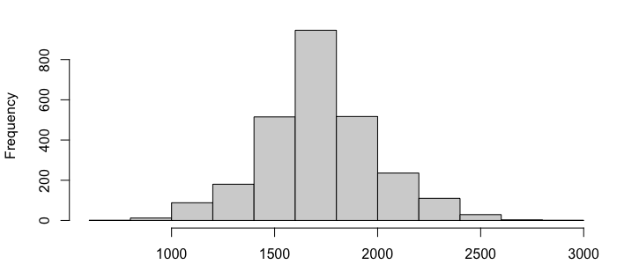
Comparing raw counts can be misleading
Raw counts
Cell_1
Cell_2
Cell_3
Normalization is required to avoid biases because of sequencing depth and make genes comparable
LogNormalize:
Feature counts for each cell are divided by the total counts for that cell and multiplied by the scale.factor. This is then natural-log transformed using log1p.
Log( Counts of Gene_A/Library Size Per Cell * scale.factor + 1)
Normalized Counts
Cell_1
Cell_2
Cell_3
Sum of Normalized Counts Per Cell

Slide 24
Scale

Slide 25
To find markers in a cell population you need to compare genes between them
Comparing genes between them when they have different spectrums of expression is challenging

Slide 26
Why Do I need to scale:
Highly expressed genes can overpower the signal of other less expressed genes with equal importance.
Within the same cell the assumption is that the underlying RNA content is constant.
SD of 1
If variables are provided in vars.to.regress, they are individually regressed against each feature, and the resulting residuals are then scaled and centered. This step allows controlling for cell cycle and other factors that may bias your clustering.

Slide 27
Expression of most variable genes in 500 cells (No scaled )

Slide 28
Expression of the most variable genes in 500 cells (scaled)

Slide 29
In simpler words:

Slide 30
Cells can have different sequencing depth
Normalization corrects biases in this direction
Cell_1
Cell_2
Cell_3

Slide 31
Features can have different expression spectrums
Cell_1
Cell_2
Cell_3
Scaling corrects biases in this direction

Slide 32
Workshop Resources
Notes:
Refer to as needed

Slide 33
Counts Matrix
Cell QC + Filter

Slide 34
Loading a counts matrix
matrix.mtx
genes.tsv
barcodes.tsv
%%MatrixMarket matrix coordinate real general
%
32738 2700 2286884
32709 1 4
32707 1 1
32706 1 10
32704 1 1
32703 1 5
32702 1 6
32700 1 10
32699 1 25
32698 1 3
32697 1 8
32527 1 1
…
ENSG00000243485 MIR1302-10
ENSG00000237613 FAM138A
ENSG00000186092 OR4F5
ENSG00000238009 RP11-34P13.7
ENSG00000239945 RP11-34P13.8
ENSG00000237683 AL627309.1
ENSG00000239906 RP11-34P13.14
ENSG00000241599 RP11-34P13.9
ENSG00000228463 AP006222.2
ENSG00000237094 RP4-669L17.10
ENSG00000235249 OR4F29
ENSG00000236601 RP4-669L17.2
ENSG00000236743 RP5-857K21.15
ENSG00000231709 RP5-857K21.1
…
AAACATACAACCAC-1
AAACATTGAGCTAC-1
AAACATTGATCAGC-1
AAACCGTGCTTCCG-1
AAACCGTGTATGCG-1
AAACGCACTGGTAC-1
AAACGCTGACCAGT-1
AAACGCTGGTTCTT-1
AAACGCTGTAGCCA-1
AAACGCTGTTTCTG-1
AAACTTGAAAAACG-1
AAACTTGATCCAGA-1
AAAGAGACGAGATA-1
AAAGAGACGCGAGA-1
…
30k genes * 10k cells = 300,000,000 measurements
= A lot of RAM!

Slide 35
Filter Cells
Cell QC + Filter

Slide 36
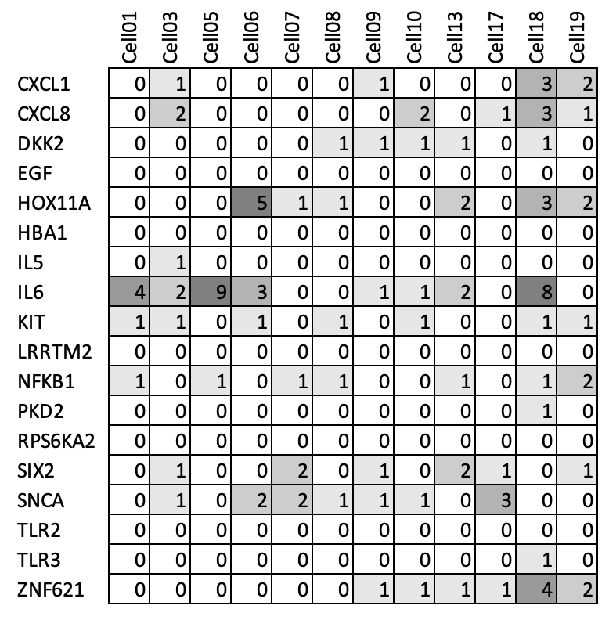
Filter Genes
Cell QC + Filter

Slide 37
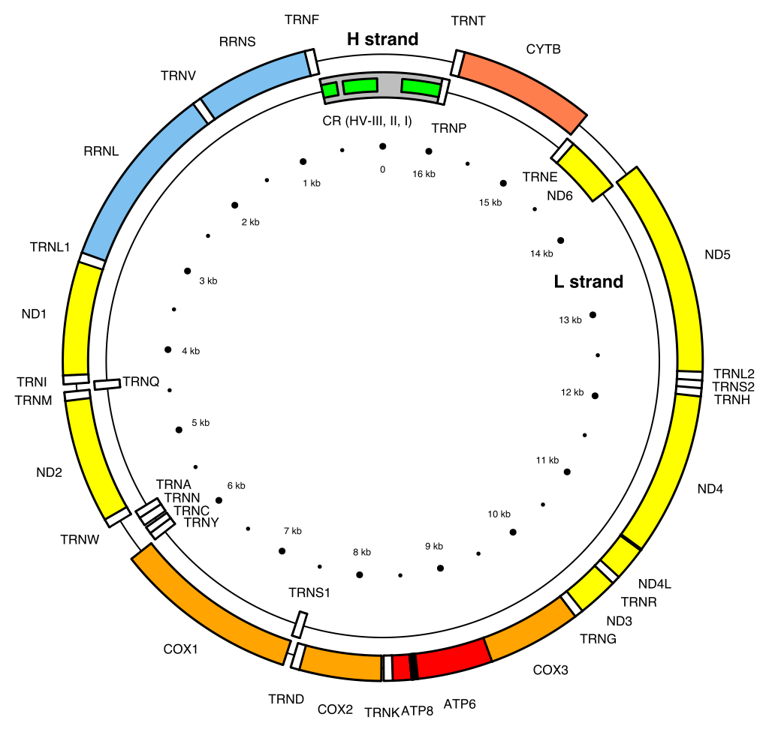
Mitochondrial Content
High mitochondrial gene content can indicate ‘dying’ cells
Uninteresting, confuses analysis
Measure the % of counts from mitochondrial genes, and remove cells with > 5%
Cell QC + Filter

Slide 38
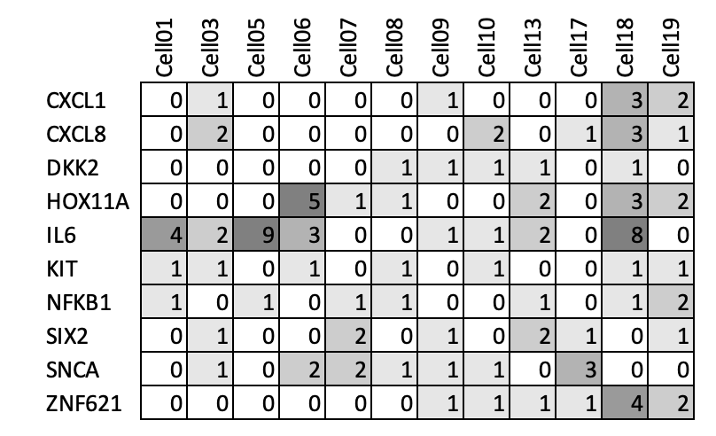
Filtered Counts matrix
Cell QC + Filter
Notes:
ACTIVITY: How many Genes?

Slide 39
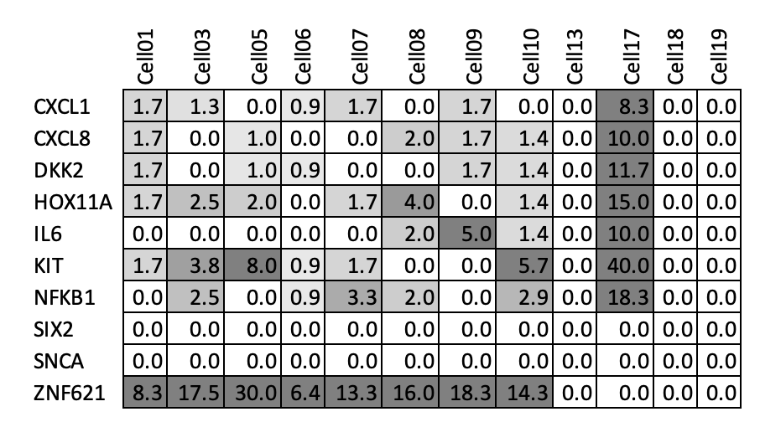
Normalisation
Normalisation

Slide 40
Highly variable Genes
Reduce dimensions

Slide 41
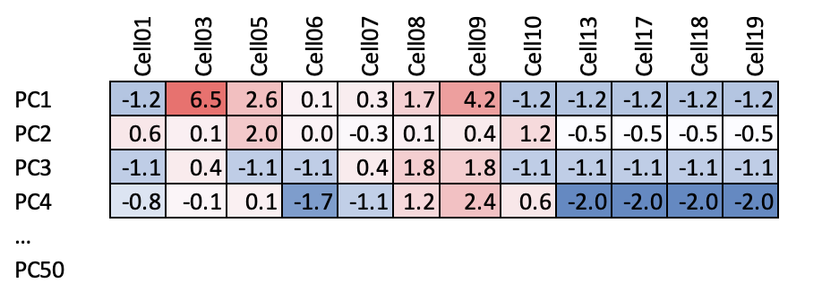
PCA
Reduce dimensions
Notes:
Talk about Variable Genes: ZNF621, - not IL6
FIND variable genes

Slide 42
Graph
09
13
03
01
17
05
08
18
10
07
06
19
Not the UMAP; Input for the UMAP and clustering
Reduce dimensions
Notes:
Never really look at this directly.
Input for UMAP, clustering (some tools ask for k nearest neighbours?.
This is why you get cells away from their cluster in UMAP

Slide 43
Clustering
09
13
03
01
17
05
08
18
10
07
06
19
Cluster
Notes:
Its never this tidy.
What is Yellow? Check its genes.
Might not need this slide

Slide 44
principal components
cell-cell neighbourhood
clusters

Slide 45
~20000
genes
~2000
variable genes
(scaled)
~20
principal components
~2
dimensions

Slide 46
Differential Expression: Cluster Markers
Marker Finding

Slide 47
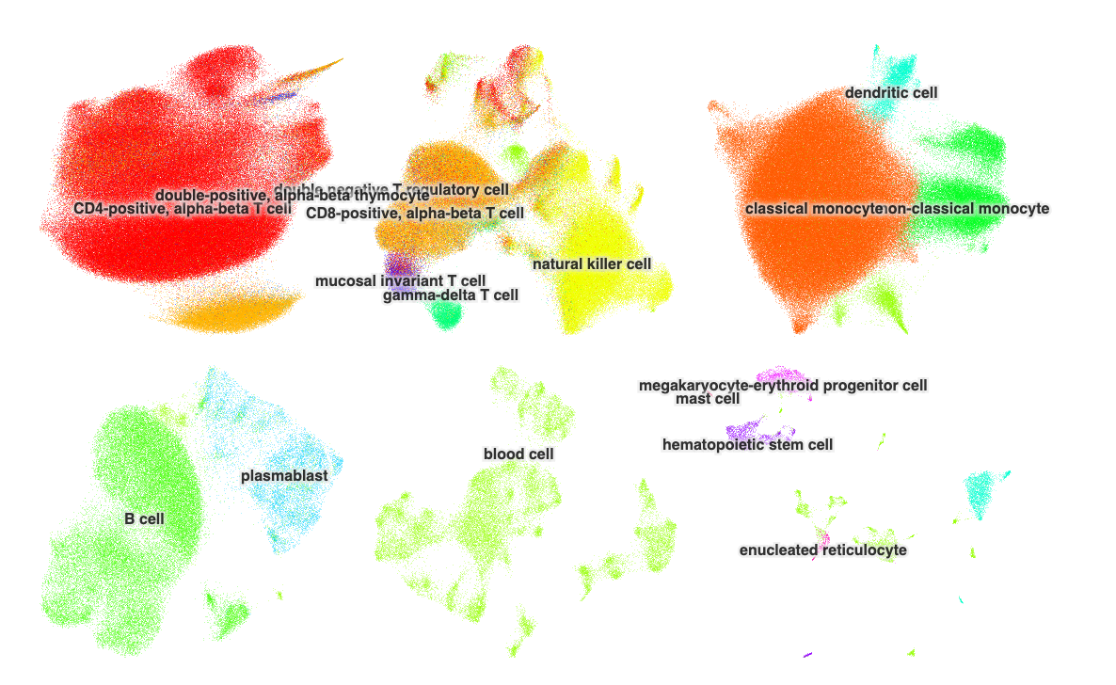
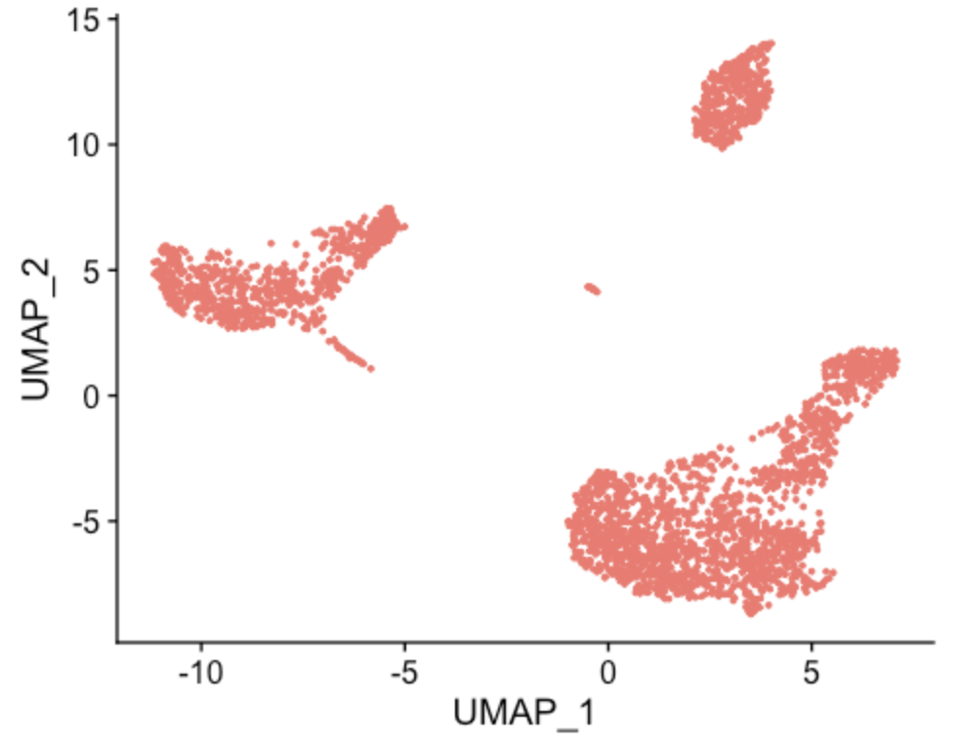
Reference based cell typing
Use a trusted cell type annotation from one experiment…
…to classify cells in another
https://cells.ucsc.edu/?ds=covid19-blood-atlas
https://www.cell.com/cell/fulltext/S0092-8674(22)00070-8
Cell type

Slide 48



Finding a reference dataset
Same tissue – or close as practical.
Counts available
Cell type annotations available
Often forgotten!
You might have to email and ask for their object
https://www.ncbi.nlm.nih.gov/geo/
https://cellxgene.cziscience.com/datasets
https://data.humancellatlas.org/explore/projects
Cell type

Slide 49
The home for lost slides

Slide 50
Cell Type Classification
Unsupervised
Clustering methods
Known cell marker genes
Manual annotation
Examples: Graphical models (Seurat clustering), RACEID
Supervised
Reference dataset
Model (training/testing)
Examples: Correlation based methods, singleR, scPred, CHETAH
Cell type

Slide 51
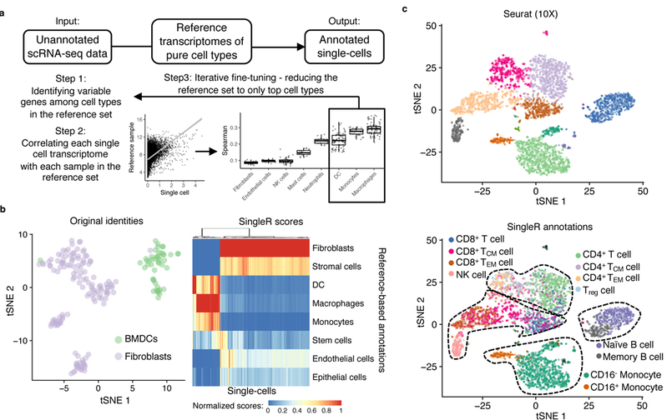
Supervised example - SingleR
SingleR
Aran, D. et al. Nat Immunol 20, 163-172 (2019). https://pubmed.ncbi.nlm.nih.gov/30643263/

Slide 52
Cell Type Analysis
Substantial effort to use scRNAseq to identify the type of cells
Cell can be organized into groups based on similar features;
Expression (gene/protein)
location
Interaction
lineage
Flow cytometry
Antibodies
Clusters based on expression
scRNAseq
genes
Clusters based on expression
Cell type

Slide 53
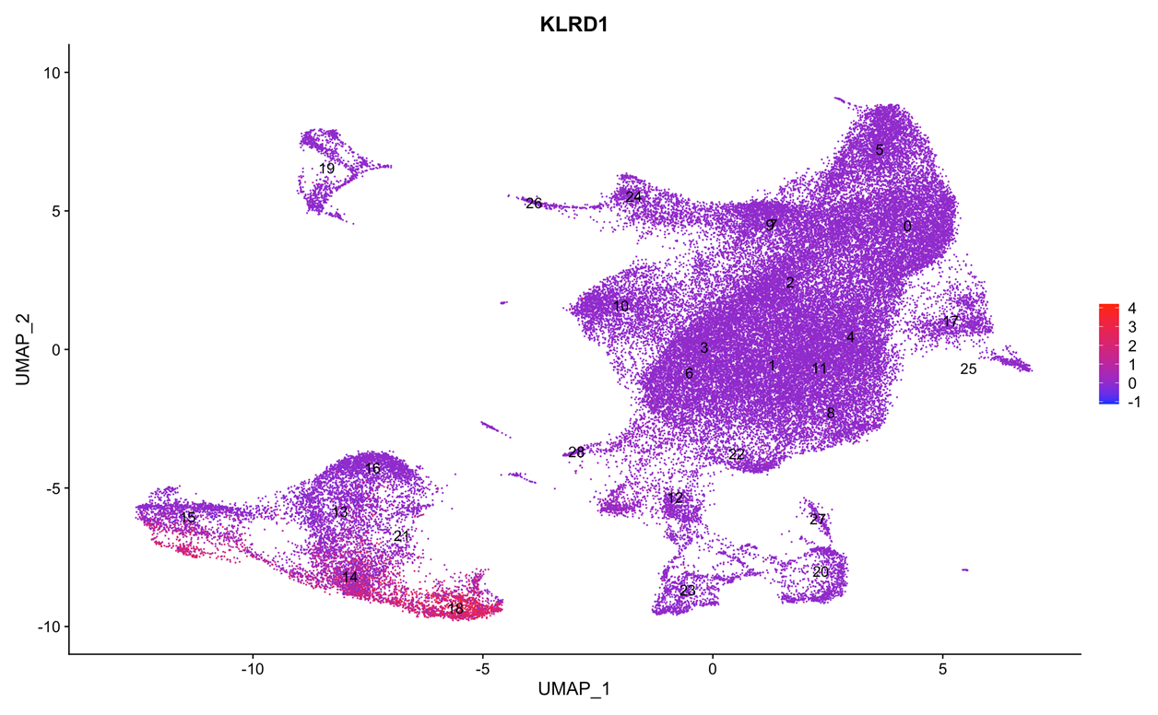
Manual annotation
Cell type

Slide 54


Differential Expression: KO vs WT
Knockout
Wildtype
Marker Finding

Slide 55
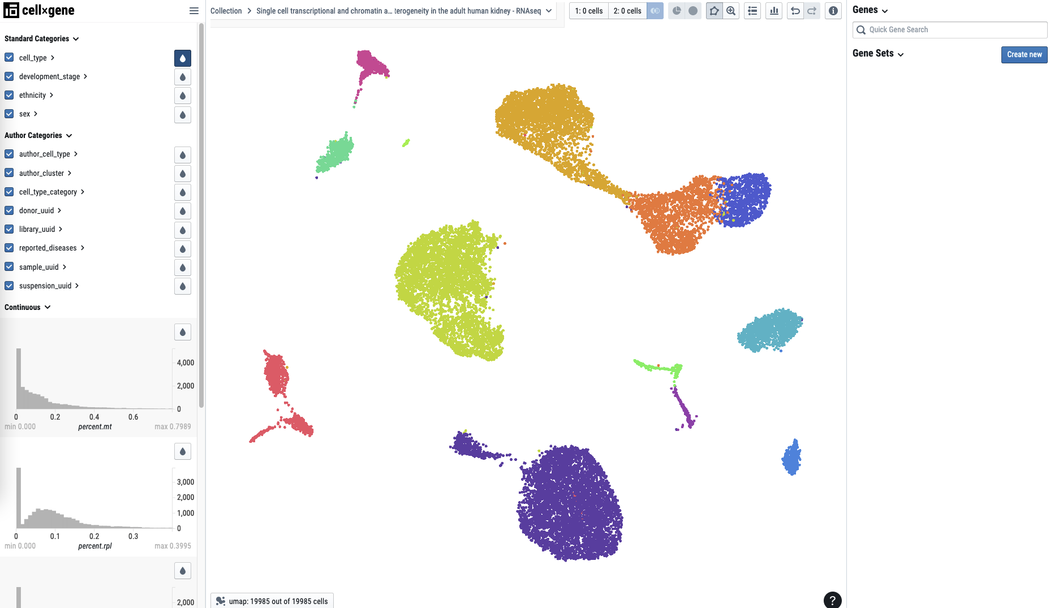
Single Cell Browsers
CellXGene
In galaxy soon
https://cellxgene.cziscience.com/e/9df60c57-fdf3-4e93-828e-fe9303f20438.cxg/
iSEE
Requires different file format
CellLoupe
Desktop application
Proprietary 10X software for 10X data only
Notes:
Need annotated data for these! Hmmm. Demo cellXgene desktop (even though its not galaxy yet) would round it off nicel - might work.

Slide 56
Finishing up

Slide 57
Where to from here?
The data is now ready for biological analysis.
Keep plotting
Load annotated data into a cell browser
Share with a collegue
Trajectories
Differential expression
Multiomics
Integration
Ligand-receptor interactions
velocity
…

Slide 58
Rdsfasdf

